Slide 1
Chapter 17
Introducing JavaFX
李晔锋

Slide 2
Key Skills & Concepts
Understand JavaFX’s concepts of a stage, a scene, a node, and a scene graph
Know the JavaFX life-cycle methods
Know the general form of a JavaFX application
Understand how to launch a JavaFX application
Create a Label
Use Button
Handle events
Use CheckBox
Work with ListView
Create a TextField
Add effects
Apply transforms

Slide 3
JavaFX Basic Concepts
JavaFX has been bundled with Java since JDK 7, update 4. The latest version of JavaFX is JavaFX 9, which is included with JDK 9. Because, at the time of this writing, JavaFX 9 represents the latest version of JavaFX,

Slide 4
The JavaFX Packages
The JavaFX framework is contained in packages that begin with the javafx prefix. At the time of this writing, there are more than 30 JavaFX packages in its API library. Here are four examples: javafx.application, javafx.stage, javafx.scene, and javafx.scene.layout.

Slide 5
The Stage（舞台） and Scene（场景） Classes
The central metaphor implemented by JavaFX is the stage.
A stage is a container for scenes and a scene is a container for the items that comprise the scene. As a result, all JavaFX applications have at least one stage and one scene. These elements are encapsulated in the JavaFX API by the Stage and Scene classes.

Slide 6
The Stage（舞台） and Scene（场景） Classes
Stage is a top-level container. All JavaFX applications automatically have access to one Stage, called the primary stage. The primary stage is supplied by the run-time system when a JavaFX application is started.
Scene is a container for the items that comprise the scene. These can consist of controls, such as push buttons and check boxes, text, and graphics. To create a scene, you will add those elements to an instance of Scene.

Slide 7
Nodes and Scene Graphs
The individual elements of a scene are called nodes.
Nodes can also consist of groups of nodes. In this case, a node with a child is called a parent node or branch node. Nodes without children are terminal nodes and are called leaves.
The collection of all nodes in a scene creates what is referred to as a scene graph, which comprises a tree.

Slide 8
Nodes and Scene Graphs
The individual elements of a scene are called nodes.
Nodes can also consist of groups of nodes. In this case, a node with a child is called a parent node or branch node. Nodes without children are terminal nodes and are called leaves.
The collection of all nodes in a scene creates what is referred to as a scene graph, which comprises a tree.
There is one special type of node in the scene graph, called the root node. This is the top-level node and is the only node in the scene graph that does not have a parent.

Slide 9
Nodes and Scene Graphs
The base class for all nodes is Node. There are several other classes that are, either directly or indirectly, subclasses of Node. These include Parent, Group, Region, and Control, to name a few.

Slide 10
Layouts
JavaFX provides several layout panes that manage the process of placing elements in a scene. For example, the FlowPane class provides a flow layout and the GridPane class supports a row/column grid-based layout. Several other layouts, such as BorderPane, are available.

Slide 11
The Application Class and the Life-cycle Methods
A JavaFX application must be a subclass of the Application class, which is packaged in javafx.application. Thus, your application class will extend Application.
The Application class defines three life-cycle methods that your application can override. These are called init( ), start( ), and stop( ), and are shown here, in the order in which they are called:
void init( )
abstract void start(Stage primaryStage)
void stop( )

Slide 12
The Application Class and the Life-cycle Methods
The init( ) method is called when the application begins execution. It is used to perform various initializations.
The start( ) method is called after init( ). This is where your application begins and it can be used to construct and set the scene.
When your application is terminated, the stop( ) method is called. It is here that you can handle any cleanup or shutdown chores.

Slide 13
Launching a JavaFX Application
To start a free-standing JavaFX application, you must call the launch( ) method defined by Application. It has two forms. Here is the one used in this chapter:
public static void launch(String ... args)
Here, args is a possibly empty list of strings that typically specify command-line arguments. When called, launch( ) causes the application to be constructed, followed by calls to init( ) and start( ). The launch( ) method will not return until after the application has terminated.

Slide 14
Create a JavaFX Program in Eclipse ---- Using Traditional Approach
Step 1: Create an ordinary Java project.
Step 2: Right click on the project name, select “Build Path” → “Configure Build Path”.
Step 3: From the popup dialog, select the “Libraries” tab, and click “Add External Jars…” button.

Slide 15
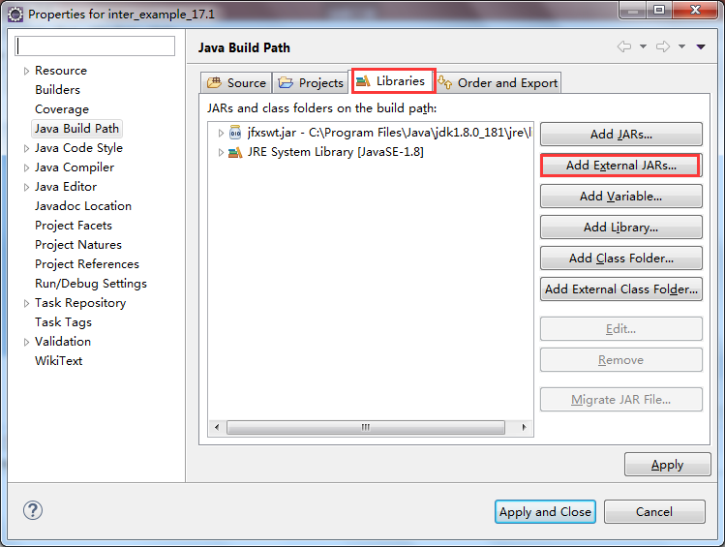
Create a JavaFX Program in Eclipse ---- Using Traditional Approach

Slide 16
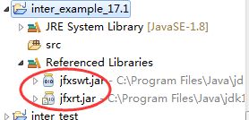
Create a JavaFX Program in Eclipse ---- Using Traditional Approach
Step 4: Try to find the “jfxrt.jar”, it is probably in your <jdk_dir>\jre\lib\ext folder.
Step 5: Click “Apply and Close” button.

Slide 17
public class JavaFXSkl extends Application {
@Override
public void start(Stage primaryStage) throws Exception {
// TODO Auto-generated method stub
System.out.println("Inside the start() method.");
primaryStage.setTitle("JavaFX Skeleton.");
FlowPane rootNode = new FlowPane();
Scene myScene = new Scene(rootNode,200,100);
primaryStage.setScene(myScene);
primaryStage.show();
}
@Override
public void init() throws Exception {
// TODO Auto-generated method stub
System.out.println("Inside the init() method.");
}
@Override
public void stop() throws Exception {
// TODO Auto-generated method stub
System.out.println("Inside the stop() method.");
}
public static void main(String[] args) {
// TODO Auto-generated method stub
System.out.println("Launching JavaFX application.");
launch(args);
}
}

Slide 18
The Application Thread
You cannot use the init( ) method to construct a stage or scene. You also cannot create these items inside the application’s constructor. The reason is that a stage or scene must be constructed on the application thread.
However, the init( ) method and the application’s constructor are called on the main thread, also called the launcher thread.
Instead, you must use the start( ) method, as the skeleton demonstrates, to create the initial GUI because start( ) is called on the application thread.

Slide 19
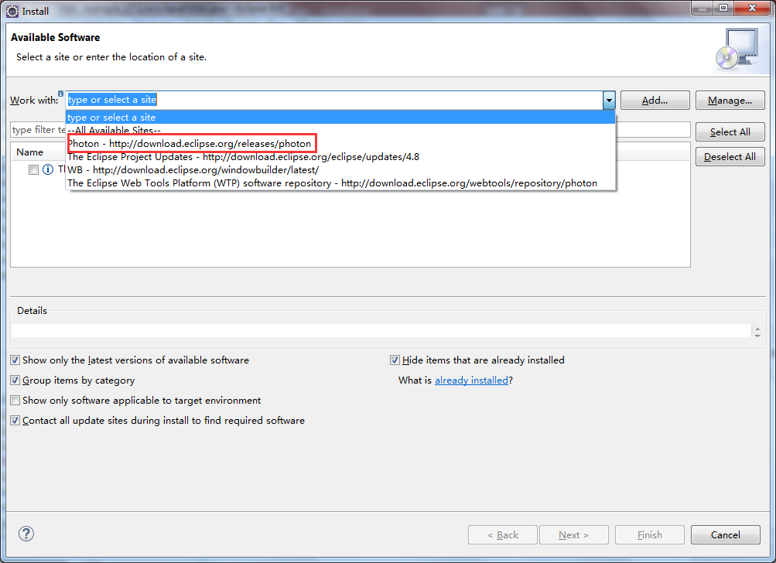
Create a JavaFX Program in Eclipse ---- Using the e(fx)clipse plugin
Similar to that of WindowBuilder, you can select “Help” → “Install New Software…”. Then click the dropdown list and select the first site.

Slide 20
Install e(fx)clipse
Select “General Purpose Tools” and you will find the “e(fx)clipse-IDE” in it. Tick on it, and click “Next”. The following processes are exactly same as that of “WindowBuilder”.
When finished installing, restart Eclipse and then you can check it in “Window” → “Preferences”.

Slide 21
Create a JavaFX Project
You may click “File” → “New” → “Other…”. In the popup dialog, expand “Java FX”, then you will find “JavaFX Project”.
The “JavaFX Project” is actually a “Java Project” which automatically import the JavaFX libraries and generate some code in the start() method.

Slide 22
Create a JavaFX Class
Sometimes, you don’t like the package “application” created for you. So you can simply create a JavaFX class by expanding “JavaFX” → “Classes” → “JavaFX Main Class” in an ordinary Java Project.
It will generate a clean class that extends Application class with start() method.

Slide 23
A Simple JavaFX Control: Label
The JavaFX label is an instance of the Label class, you can call its constructor like this:
Label(String str)
The string that is displayed is specified by str.

Slide 24
Add the Label to a Scene
Once you have created a label (or any other control) it must be added to the scene’s content, which means adding it to the scene graph.
To do this, you will first call getChildren( ) on the root node of the scene graph. It returns a list of the child nodes in the form of an ObservableList<Node>.
ObservableList is packaged in javafx.collections, and it inherits java.util.List, so it is similar to ArrayList, and you can use the add() method to do this.

Slide 25
public class JavaFXLabelDemo extends Application {
@Override
public void start(Stage primaryStage) {
primaryStage.setTitle("Use a JavaFX label.");
FlowPane rootNode = new FlowPane();
Scene myScene = new Scene(rootNode,300,200);
primaryStage.setScene(myScene);
Label myLabel = new Label("JavaFX is a powerful GUI");
rootNode.getChildren().add(myLabel);
primaryStage.show();
}
public static void main(String[] args) {
launch(args);
}
}

Slide 26
Using Buttons and Events
In many ways, event handling in JavaFX is similar to event handling in Swing as shown in the preceding chapter, but it’s more streamlined.

Slide 27
Event Basics
The base class for JavaFX events is the Event class, it inherits java.util.EventObject, Several subclasses of Event are defined. The one that we will use here is ActionEvent. It encapsulates action events generated by a button.

Slide 28
Event Handling
Events are handled by implementing the EventHandler interface, It is a generic interface with the following form:
Interface EventHandler<T extends Event>
Here, T specifies the type of event that the handler will handle. It defines one method, called handle( ), which receives the event object as a parameter. It is shown here:
void handle(T eventObj)
In this case, eventObj is the event that was generated.

Slide 29
Introducing the Button Control
The Button constructor we will use is shown here:
Button(String str)
In this case, str is the message that is displayed in the button.
When a button is pressed, an ActionEvent is generated. You can register a listener for this event by calling setOnAction( ) on the button. It has this general form:
final void setOnAction(EventHandler<ActionEvent> handler)
Here, handler is the handler being registered.

Slide 30
public class JavaFXEventDemo extends Application {
Label response;
@Override
public void start(Stage primaryStage) {
primaryStage.setTitle("Use JavaFX Buttons and Events.");
FlowPane rootNode = new FlowPane(10,10);
rootNode.setAlignment(Pos.CENTER);
Scene myScene = new Scene(rootNode,300,100);
primaryStage.setScene(myScene);
response = new Label("Push a Button");
Button btnUp = new Button("Up");
Button btnDown = new Button("Down");
btnUp.setOnAction(new EventHandler<ActionEvent>() {
public void handle(ActionEvent ae) {
response.setText("You pressed up.");
}
});
btnDown.setOnAction(new EventHandler<ActionEvent>() {
public void handle(ActionEvent ae) {
response.setText("You pressed down.");
}
});
rootNode.getChildren().addAll(btnUp,btnDown,response);
primaryStage.show();
}
public static void main(String[] args) {
launch(args);
}
}

Slide 31
CheckBox
CheckBox supports three states. The first two are checked or unchecked, the third state is indeterminate (also called undefined). Here is the CheckBox constructor that we will use:
CheckBox(String str)
It creates a check box that has the text specified by str as a label.

Slide 32
public class CheckboxDemo extends Application {
CheckBox cbSmartphone;
CheckBox cbTablet;
CheckBox cbNotebook;
CheckBox cbDesktop;
Label response;
Label selected;
String computers;
@Override
public void start(Stage primaryStage) {
primaryStage.setTitle("Demonstrate Check Boxes");
FlowPane rootNode = new FlowPane(Orientation.VERTICAL,10,10);
rootNode.setAlignment(Pos.CENTER);
Scene myScene = new Scene(rootNode,500,200);
primaryStage.setScene(myScene);
Label heading = new Label("What Computers Do You Own?");
response = new Label("");
selected = new Label("");
cbSmartphone = new CheckBox("SmartPhone");
cbTablet = new CheckBox("Tablet");
cbNotebook = new CheckBox("Notebook");
cbDesktop = new CheckBox("Desktop");

Slide 33
cbSmartphone.setOnAction((ae)->{
if(cbSmartphone.isSelected())
response.setText("Smartphone was just selected.");
else
response.setText("Smartphone was just cleared.");
showAll();
});
cbTablet.setOnAction((ae)->{
if(cbTablet.isSelected())
response.setText("Tablet was just selected.");
else
response.setText("Tablet was just cleared.");
showAll();
});
cbNotebook.setOnAction((ae)->{
if(cbNotebook.isSelected())
response.setText("Notebook was just selected.");
else
response.setText("Notebook was just cleared.");
showAll();
});

Slide 34
cbDesktop.setOnAction((ae)->{
if(cbDesktop.isSelected())
response.setText("Desktop was just selected.");
else
response.setText("Desktop was just cleared.");
showAll();
});
rootNode.getChildren().addAll(heading, cbSmartphone, cbTablet,
cbNotebook, cbDesktop, response, selected);
primaryStage.show();
showAll();
}
void showAll() {
computers = "";
if(cbSmartphone.isSelected()) computers = "Smartphone ";
if(cbTablet.isSelected()) computers += "Tablet ";
if(cbNotebook.isSelected()) computers+="Notebook ";
if(cbDesktop.isSelected()) computers+="Desktop";
selected.setText("Computers selected: " + computers);
}
public static void main(String[] args) {
launch(args);
}
}

Slide 35
ListView
ListView is a generic class that is declared like this:
class ListView<T>
Here, T specifies the type of entries stored in the list view. Often, these are entries of type String, but other types are also allowed. Here is the ListView constructor that we will use:
ListView(ObservableList<T> list)
The list of items to be displayed is specified by list. It is an object of type ObservableList

Slide 36
ListView
Probably the easiest way to create an ObservableList for use in a ListView is to use the factory method observableArrayList( ). The version we will use is shown here:
static <E> ObservableList<E> observableArrayList(E ... elements)
In this case, E specifies the type of elements, which are passed via elements.

Slide 37
ListView
Although ListView provides a default size, sometimes you will want to set the preferred height and/or width to best match your needs. One way to do this is to call the setPrefHeight( ) and setPrefWidth( ) methods, shown here:
final void setPrefHeight(double height)
final void setPrefWidth(double width)
Alternatively, you can use a single call to set both dimensions at the same time by use of setPrefSize( ), shown here:
void setPrefSize(double width, double height)

Slide 38
Event Handling of a ListView
The event handling mechanism for a ListView is supported by the ChangeListener interface. It defines only one method, called changed( ), shown here:
void changed(ObservableValue<? extends T> changed, T oldVal, T newVal)
In this case, changed is the instance of ObservableValue<T> which encapsulates an object that can be watched for changes. The oldVal and newVal parameters pass the previous value and the new value, respectively. Thus, in this case, newVal holds a reference to the list item that has just been selected.

Slide 39
Event Handling of a ListView
To listen for change events, you must first obtain the selection model used by the ListView. This is done by calling getSelectionModel( ) on the list. It is shown here:
final MultipleSelectionModel<T> getSelectionModel( )
Using the model returned by getSelectionModel( ), you will obtain a reference to the selected item property that defines what takes place when an element in the list is selected. This is done by calling selectedItemProperty( ), shown next:
final ReadOnlyObjectProperty<T> selectedItemProperty( )

Slide 40
Event Handling of a ListView
You will add the change listener to this property by using the addListener( ) method on the returned property. The addListener( ) method is shown here:
void addListener(ChangeListener<? super T> listener)
In this case, T specifies the type of the property.

Slide 41
public class ListViewDemo extends Application {
Label response;
@Override
public void start(Stage primaryStage) {
primaryStage.setTitle("ListView Demo.");
FlowPane rootNode = new FlowPane(10,10);
rootNode.setAlignment(Pos.CENTER);
Scene myScene = new Scene(rootNode,200,120);
primaryStage.setScene(myScene);
response = new Label("Select Computer Type:");
ObservableList<String> computerTypes =
FXCollections.observableArrayList("Smartphone","Tablet","Notebook","Desktop");
ListView<String> lvComputers = new ListView<String>(computerTypes);
lvComputers.setPrefSize(100, 70);

Slide 42
MultipleSelectionModel<String> lvSelModel = lvComputers.getSelectionModel();
lvSelModel.selectedItemProperty().addListener(new ChangeListener<String>() {
@Override
public void changed(ObservableValue<? extends String> changed,
String oldVal, String newVal) {
// TODO Auto-generated method stub
response.setText("Computer selected is " + newVal);
}
});
rootNode.getChildren().addAll(lvComputers,response);
primaryStage.show();
}
public static void main(String[] args) {
launch(args);
}
}

Slide 43
TextField
TextField defines two constructors. The first is the default constructor, which creates an empty text field that has the default size. The second lets you specify the initial contents of the field.
You can set the text in a text field by calling setText( ). You can obtain the current text by calling getText( ).
One especially useful TextField option is the ability to set a prompting message inside the text field when the user attempts to use a blank field. To do this, call setPromptText( ), shown here:
final void setPromptText(String str)

Slide 44
Handling TextField Events
When the user presses ENTER while inside a TextField, an action event is generated. It is done by ActionEvent.

Slide 45
public class TextFieldDemo extends Application {
TextField tf;
Label response;
@Override
public void start(Stage primaryStage) {
primaryStage.setTitle("Demonstrate a Textfield");
FlowPane rootNode = new FlowPane(10,10);
rootNode.setAlignment(Pos.CENTER);
Scene myScene = new Scene(rootNode,230,140);
primaryStage.setScene(myScene);
response = new Label("Enter name:");
Button btnGetText = new Button("Get Name");
tf = new TextField();
tf.setPromptText("Enter a name.");
tf.setPrefColumnCount(15);
tf.setOnAction((ae)->response.setText("Enter pressed. Name is “ + tf.getText()));
btnGetText.setOnAction((ae)->response.setText("Button pressed. Name is "+ tf.getText()));
Separator separator = new Separator();
separator.setPrefWidth(180);
rootNode.getChildren().addAll(tf,btnGetText,separator,response);
primaryStage.show();
}
public static void main(String[] args) {
launch(args);
}
}

Slide 46
Introducing Effects and Transforms
A principal advantage of JavaFX is its ability to alter the precise look of a control (or any node in the scene graph) through the application of an effect and/or a transform.

Slide 47
public class EffectsAndTransformsDemo extends Application {
double angle = 0.0;
double scaleFactor = 0.4;
double blurVal = 1.0;
Reflection reflection = new Reflection();
BoxBlur blur = new BoxBlur(1.0,1.0,1);
Rotate rotate = new Rotate();
Scale scale = new Scale(scaleFactor,scaleFactor);
Button btnRotate = new Button("Rotate");
Button btnBlur = new Button("Blur off");
Button btnScale = new Button("Scale");
Label reflect = new Label("Reflection Adds Visual Sparkle");

Slide 48
@Override
public void start(Stage primaryStage) {
primaryStage.setTitle("Effects and Transform Demo");
FlowPane rootNode = new FlowPane(20,20);
rootNode.setAlignment(Pos.CENTER);
Scene myScene = new Scene(rootNode,300,120);
primaryStage.setScene(myScene);
btnRotate.getTransforms().add(rotate);
btnScale.getTransforms().add(scale);
reflection.setTopOpacity(0.7);
reflection.setBottomOpacity(0.3);
reflect.setEffect(reflection);
btnRotate.setOnAction((ae)->{
angle += 15.0;
rotate.setAngle(angle);
rotate.setPivotX(btnRotate.getWidth()/2);
rotate.setPivotY(btnRotate.getHeight()/2);
});

Slide 49
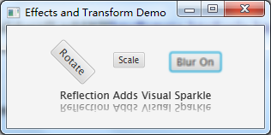
btnScale.setOnAction((ae)->{
scaleFactor += 0.1;
if(scaleFactor > 2.0) scaleFactor = 0.4;
scale.setX(scaleFactor);
scale.setY(scaleFactor);
});
btnBlur.setOnAction((ae)->{
if(blurVal == 10.0) {
blurVal = 1.0;
btnBlur.setEffect(null);
btnBlur.setText("Blur Off");
}else {
blurVal++;
btnBlur.setEffect(blur);
btnBlur.setText("Blur On");
}
blur.setWidth(blurVal);
blur.setHeight(blurVal);
});
rootNode.getChildren().addAll(btnRotate,btnScale,btnBlur,reflect);
primaryStage.show();
}

Slide 50
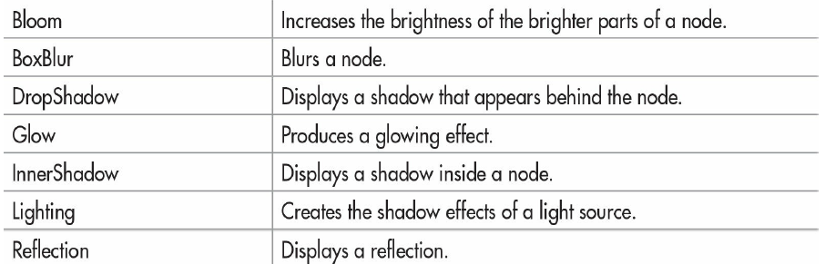
Effects
Effects are supported by the abstract Effect class and its concrete subclasses. Using these effects, you can customize the way a node in a scene graph looks. Several built-in effects are provided. Here is a sampling:

Slide 51
Effects
To set an effect on a node, call setEffect( ), which is defined by Node. It is shown here:
final void setEffect(Effect effect)
In this case, effect is the effect that will be applied. To specify no effect, pass null.

Slide 52
BoxBlur Effect
BoxBlur blurs the node on which it is used. It supplies two constructors. Here is the constructor that we will use:
BoxBlur(double width, double height, int iterations)
Here, width and height specify the size of box into which a pixel will be blurred. These values must be between 0 and 255, inclusive. The number of times that the blur effect is applied is specified by iterations, which must be between 0 and 3, inclusive.

Slide 53
BoxBlur Effect
After a BoxBlur instance has been created, the width and height of the box can be changed by using setWidth( ) and setHeight( ), shown here:
final void setWidth(double width)
final void setHeight(double height)
The number of iterations can be changed by calling setIterations( ):
final void setIterations(int iterations)

Slide 54
Reflection Effect
Reflection produces an effect that simulates a reflection of the node on which it is called. It is particularly useful on text, such as that contained in a label. These can set by the following Reflection constructor:
Reflection(double offset, double fraction, double topOpacity, double bottomOpacity)

Slide 55
Reflection Effect
The offset, amount shown, and opacities can also be changed during program execution.
final void setTopOpacity(double opacity)
final void setBottomOpacity(double opacity)
final void setTopOffset(double offset)
final void setFraction(double amount)

Slide 56
Transforms
Transforms are supported by the abstract Transform class. Four of its subclasses are Rotate, Scale, Shear, and Translate. One way to add a transform to a node is to add it to the list of transforms maintained by the node. This list is obtained by calling getTransforms( ), which is defined by Node. It is shown here:
final ObservableList<Transform> getTransforms( )
It returns a reference to the list of transforms. To add a transform, simply add it to this list by calling add( ). You can clear the list by calling clear( ). You can use remove( ) to remove a specific element.

Slide 57
The Rotate Transform
Rotate rotates a node through a specified angle around a specified point. These values can be set when a Rotate instance is created.
Rotate(double angle, double x, double y)
In this case, angle specifies the number of degrees to rotate. The center of rotation, called the pivot point, is specified by x and y.

Slide 58
The Rotate Transform
It is also possible to use the default constructor and set the rotation values after a Rotate object has been created, shown here:
final void setAngle(double angle)
final void setPivotX(double x)
final void setPivotY(double y)

Slide 59
The Scale Transform
Scale scales a node as specified by a scale factor. Thus, it changes a node’s size. Scale defines several constructors. Here is the one that we will use:
Scale(double widthFactor, double heightFactor)
In this case, widthFactor specifies the scaling factor applied to the node’s width, and heightFactor specifies the scaling factor applied to the node’s height. These factors can be changed after a Scale instance has been created by using setX( ) and setY( ), shown here:
final void setX(double widthFactor)
final void setY(double heightFactor)

Slide 60
Color
Color is a widely used class in JavaFX. It is a subclass of Paint. You can specify the color attribute on any node, including the scene. You can create a Color object in various ways, such as:
Color c = Color.BLUE;
Color c = new Color(0,0,1,1.0);
Color c = Color.rgb(0,0,255,1.0);
Color c = Color.web(“0x0000FF”,1.0);
You can easily create a scene with color BLACK:
Scene scene = new Scene(root, 800, 600, Color.BLACK);

Slide 61
Shapes
In JavaFX, shapes are also considered as Nodes, and can be added to a scene. The abstract class Shape extends the following class to create a specific shape:
Arc
Line
Circle
Rectangle
Ellipse
Polygon
Text
…

Slide 62
Key Methods in Shape
The following are most widely used methods in the subclasses of Shape:
void setFill(Paint color);
void setStroke(Paint color);
void setStrokeType(StokeType type);
void setStrokeWidth(int value);
Particularly, StrokeType is an Enum, it has three constants: CENTERED, INSIDE, OUTSIDE.

Slide 63
Line
The most commonly used constructor of a Line object is:
Line(double startX, double startY, double endX, double endY)
Here, (startX, startY) is the starting coordinate of the line, and (endX, endY) is the ending axis of the line.
You can also specify the properties later by calling the following methods:
void setStartX(double value)
void setStartY(double value)
void setEndX(double value)
void setEndY(double value)

Slide 64
Rectangle
The most commonly used constructor is:
Rectangle(double x, double y, double width, double height)
Here, (x,y) is the upper-left coordinate of the rectangle, width and height are for their meaning.

Slide 65
Circle
The most commonly used constructor is:
Circle(double centerX, double centerY, double radius)
Here, (centerX, centerY) is the coordinate of center, and radius is for the radius of circle.

Slide 66
Polygon
A polygon consists of pointers that forms its vertices. You can directly create an empty instance of Polygon:
Polygon p = new Polygon();
Then, add the vertices in the form of Double[] array.
p.getPoints.addAll(new Double[]{
200.0, 100.0,
100.0, 200.0,
300.0, 200.0
});

Slide 67
The Group Node
A Group node contains an ObservableList of children that are rendered in order whenever this node is rendered.
A Group will take on the collective bounds of its children and is not directly resizable.

Slide 68
public void start(Stage primaryStage) {
Group root = new Group();
Scene scene = new Scene(root, 800, 600, Color.BLACK);
primaryStage.setScene(scene);
Rectangle rect = new Rectangle(100,100,100,100);
rect.setFill(Color.RED);
rect.setStroke(Color.BLUE);
rect.setStrokeType(StrokeType.CENTERED);
rect.setStrokeWidth(20);
Circle circle = new Circle(350,150,100);
circle.setFill(Color.RED);
circle.setStroke(Color.BLUE);
circle.setStrokeType(StrokeType.INSIDE);
circle.setStrokeWidth(20);
Polygon p = new Polygon();
p.getPoints().addAll(new Double[] {
600.0, 100.0, 500.0, 200.0, 700.0, 200.0
});
p.setFill(Color.RED);
p.setStroke(Color.BLUE);
p.setStrokeType(StrokeType.OUTSIDE);
p.setStrokeWidth(20);
Line line = new Line(100,400,600,400);
line.setStroke(Color.GREEN);
line.setStrokeWidth(10);
root.getChildren().addAll(rect,circle,p,line);
primaryStage.show();
}

